Slide 1

The Standard Error of Difference
Dr Oliver Clark

Slide 2
This Video
When is a difference a difference?
Comparing scores on different measures
Comparing scores on the same measure

Slide 3
When is a difference a difference?
Candidate 1 = 5.4
Candidate 2 = 5.6

Slide 4
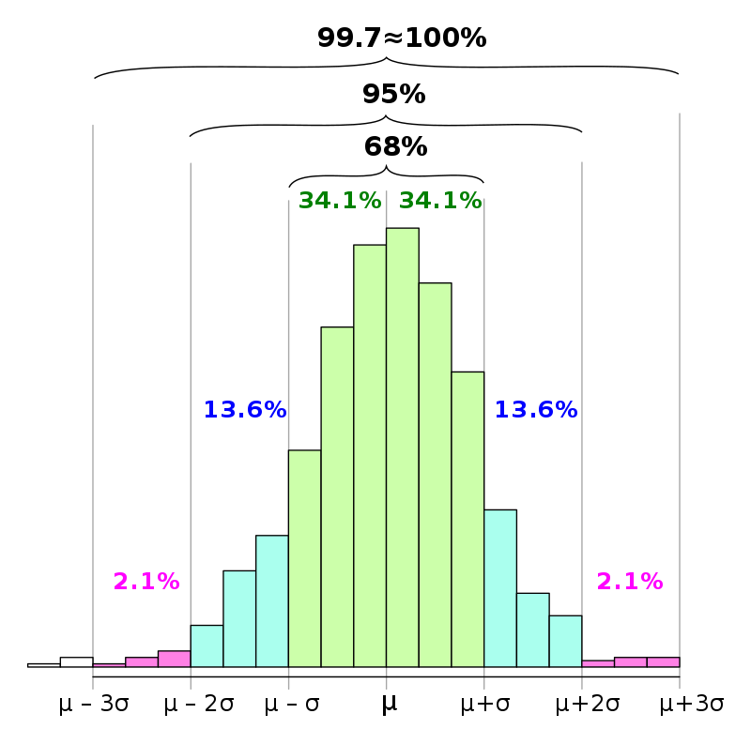
When is a difference a difference?
Candidate 1
Candidate 2
True score

Slide 5
When is a difference a difference?
Candidate 1
Candidate 2
True score

Slide 6

When is a difference a difference?
$$SEDiff= \sqrt{SEM2+SEM2}$$

Slide 7


When is a difference a difference?
Candidate 1 = 5.4
Candidate 2 = 5.6
From our Sample:
Omega Reliability = 0.88
Mean = 4.47
SD = 0.72
$$SEDiff= SD×\sqrt{2−r_{xx1}− r_{xx2}}$$
Two measures
$$SEM ×\sqrt{2} ≈SEM×1.414$$
One measure

Slide 8



When is a difference a difference?
Candidate 1 = 5.4
Candidate 2 = 5.6
From our Sample:
Omega Reliability = 0.88
Mean = 4.47
SD = 0.72
$$SEM ×\sqrt{2} ≈SEM×1.414$$
SEM =$SD×\sqrt{1−r_{xx}}$
SEM =$0.72×\sqrt{1−0.88}$
SEM =$0.72×\sqrt{0.12}=0.72 × 0.35=0.252$
SEDIFF = 1.414*0.252 = 0.37

Slide 9
When is a difference a difference?
Candidate 1 = 5.4
Candidate 2 = 5.6
Difference = 5.6 - 5.4 = 0.2
0.2< 0.37

Slide 10

Two Different Scores
$SEDiff= SD×\sqrt{2−r_{xx1}− r_{xx2}}$
Our Data
Agree = 4.75 (0.58)
Omega = 0.79
Extra = 4.27 (0.75)
Omega 0.88
Candidate: Agreeableness = 4.2, Extraversion = 4.5

Slide 11

Two Different Scores
$z=\frac{Observed−Mean}{SD}$
Our Data
Agree = 4.75 (0.58)
Omega = 0.79
Extra = 4.27 (0.75)
Omega 0.88
Candidate: Agreeableness = 4.2, Extraversion = 4.5
Aggree Z = (4.2-4.75) / 0.58= -0.95
T = 40.05
T =53
Extra Z = (4.5-4.27) / 0.75= 0.3

Slide 12
Two Different Scores
$SEDiff= SD×\sqrt{2−r_{xx1}− r_{xx2}}$
Our Data
Agree = 4.75 (0.58)
Omega = 0.79
Extra = 4.27 (0.75)
Omega 0.88
Candidate:
Agreeableness = 4.2
Extraversion = 4.5
Agree T= 40.05
Extra T = 53
$$SEDiff=10×\sqrt{2−0.88−0.79}=10×0.575=5.75$$

Slide 13
Two Different Scores
Agree T= 40.05
Extra T = 53
53-40.05 = 12.95 > 5.75
$$SEDiff=10×\sqrt{2−0.88−0.79}=10×0.575=5.75$$

Slide 14
Differences
Standard Error of Difference accounts for multiple sources of error
It lets us infer whether a difference is likely down to sampling error
Good for comparing scores within and between individuals

